Slide 2
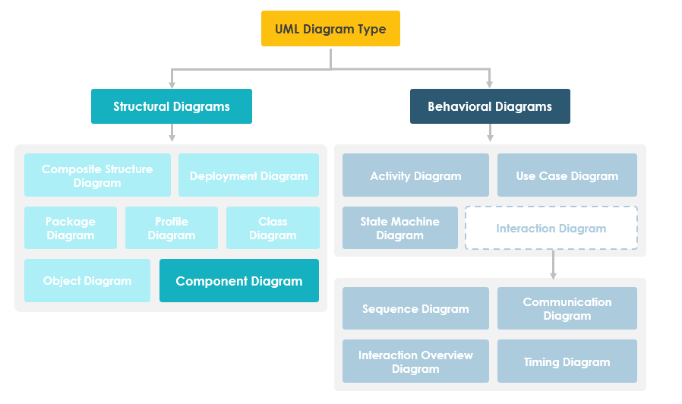

Slide 3

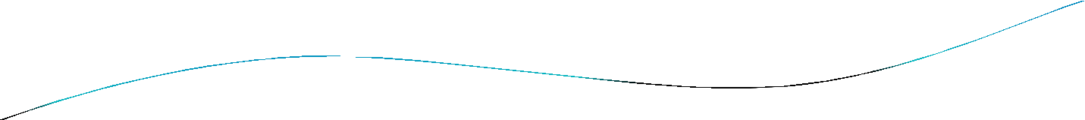


Implementation Diagrams
Both are structural diagrams
Component Diagrams:
set of components and their relationships
Illustrate static implementation view
Component maps to one or more classes, interfaces, or
collaborations
Deployment Diagrams:
Set of nodes and their relationships
Illustrate static deployment view of architecture
Node typically encloses one or more components

Slide 4

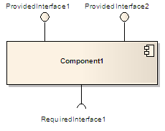

Component (UML)
 A component in the Unified Modeling
Language "represents a modular part of a system, that encapsulates its content and whose manifestation is replaceable within its environment. A component defines its behavior in terms of provided and
required interfaces".^{[1]}
Manifestation : an event, action, or object that clearly shows or embodies something abstract or theoretical.

Slide 5
Component (UML)
Components are used to create reusable pieces of code.
Components are combined to create whole program
Components must communicate through interfaces it must be loosely couple
A component is similar to a black box whose external behavior is defined by a provided interface and required interfaces.

Slide 6

Component (UML)
A component may be replaced by another if and only if their provided and required interfaces are identical.
This idea promotes software reuse.
UML places no restriction on the granularity of a component. Thus, a component may be as small as a figures-to-words converter, or as large as an
entire document management system.
Such assemblies are illustrated by means of component diagrams.

Slide 7

Package
General purpose mechanism for organizing elements into groups
Can group classes or components.
Package Name

Slide 8


Component Diagram
Classes
Interfaces
Dependency, generalization, association, and realization relationships
Example.java
Special kind of class diagram focusing on system’s components.
A component is a logical unit block of the system, a slightly higher abstraction than classes.

Slide 9

Component
A rectangle with the component's name
A rectangle with the component icon Component icon: It is represented as a rectangle with a smaller rectangle in the upper right corner with tabs
A rectangle with the stereotype text and/or icon

Slide 10
Interface in Component Diagram
The Interface is a named set of public features. It separates the specification of functionality from its implementation by a class diagram or a subsystem. An interface symbol cannot be instantiated. It declares a contract that may be realized by zero or more classifiers such as a class or a subsystem.
There are two types of Interfaces in Component Diagram:
Provided interfaces
Required interfaces

Slide 11
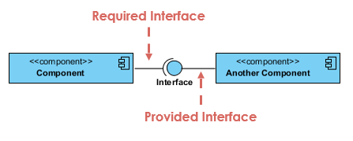
Interface in Component Diagram
Provided interface symbols with a complete circle at their end represent an interface that the component creates/provides - this "lollipop" symbol is shorthand for a realization relationship of an interface classifier.
Required Interface symbols with only a half circle at their end (a.k.a. sockets) represent an interface that the component uses/requires (in both cases, the interface's name is placed near the interface symbol itself).

Slide 12

Interfaces
Definition:
Collection of operation signatures and/or attribute defns
Defines a cohesive set of behaviors
Realized by:
Implemented by classes and components
Implement operations/attributes defined by interface
Relationships:
A class can implement 0ne or more interfaces
An interface can be implemented by 1 or more classes
Notation:
Lollipop
Dashed arrow

Slide 13
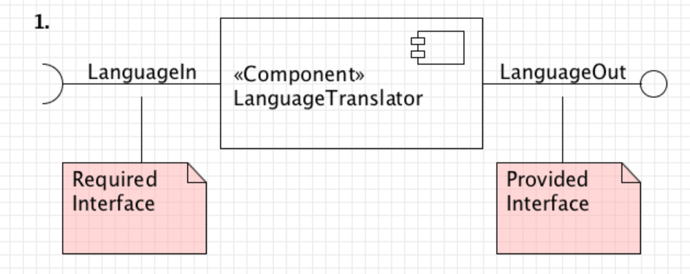
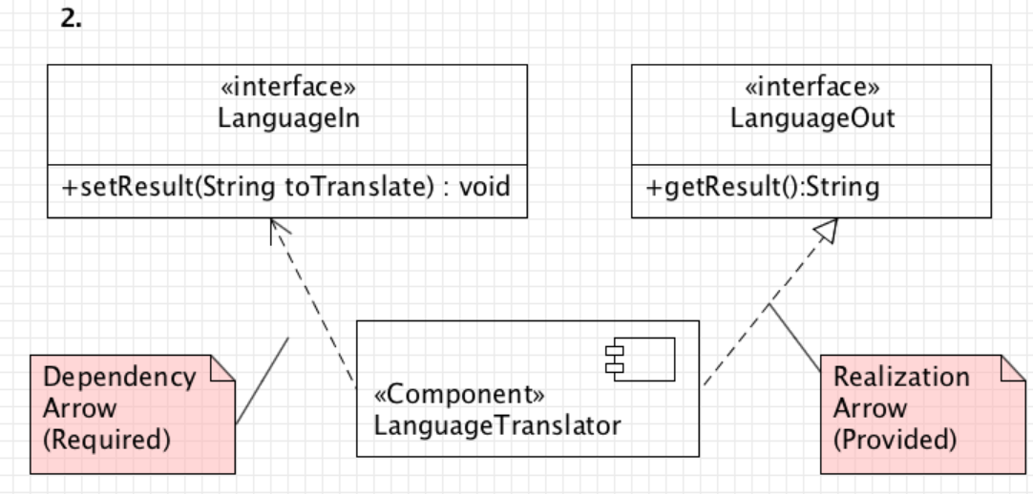
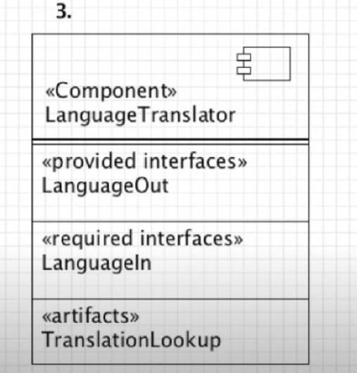
3 ways to show required and provided interfaces

Slide 14
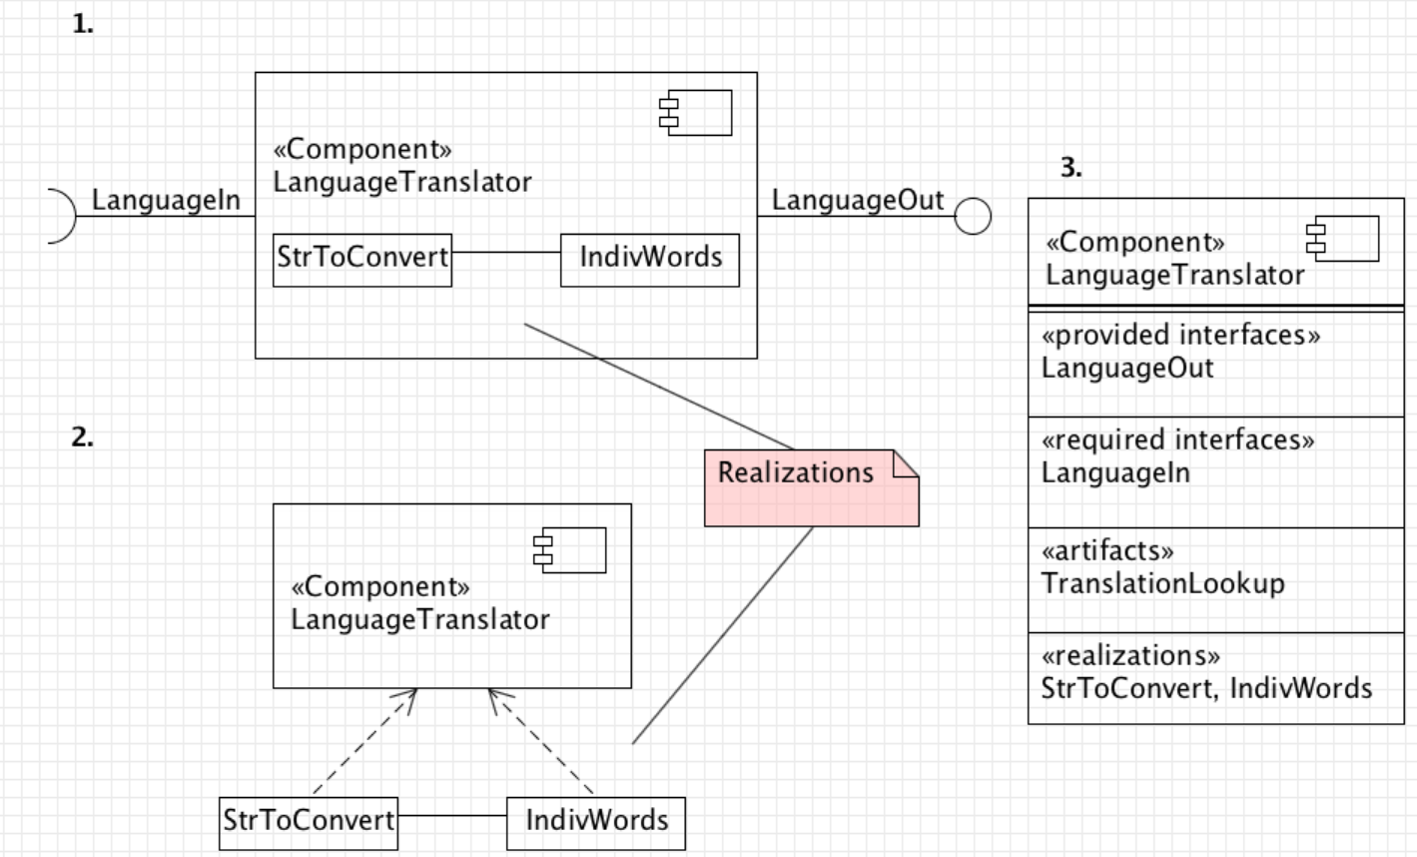
3 ways to show classes inside a component

Slide 15
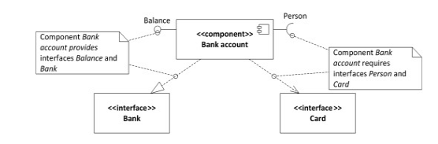
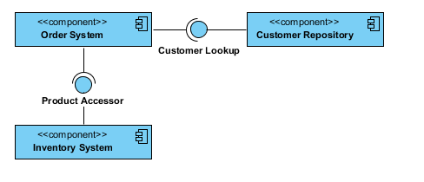
Component Diagram Example - Using Interface (Order System)

Slide 16
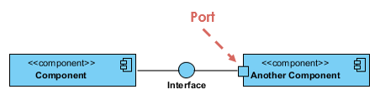
Port
Ports are represented using a square along the edge of the system or a component.
A Port is an interaction point between a classifier and an external environment. It groups semantically cohesive set of provided and required interfaces. A port can be used in UML without specifying the name of the port. A port may have visibility. When a port is drawn over the boundary of a classifier, then it means that the port is public. It also means that all the interfaces used are made as public.
When a port is drawn inside the classifier, then it is either protected or private.
A port also has multiplicity that indicates the number of instances of the port classifier will have. A port in UML diagram is denoted as given below:

Slide 17
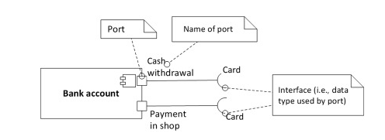
Port
There can be multiple ports providing or requiring the same interface. It allows greater control over implementation and interaction with other components. Fig. considers component with two named ports that each requires the same interface. The first port Cash withdrawal is used when bank’s client takes out cash from automated teller machine (ATM) using his card. The other port named Payment in shop is used when making payments with card at shop.

Slide 18
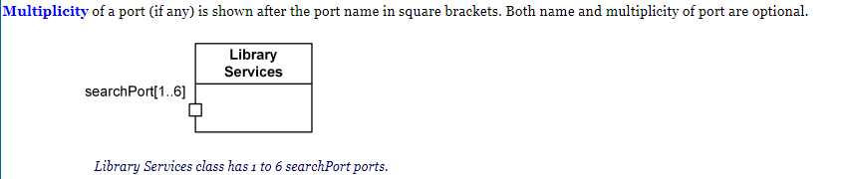
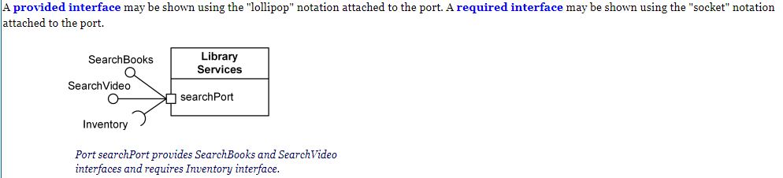
Port

Slide 19
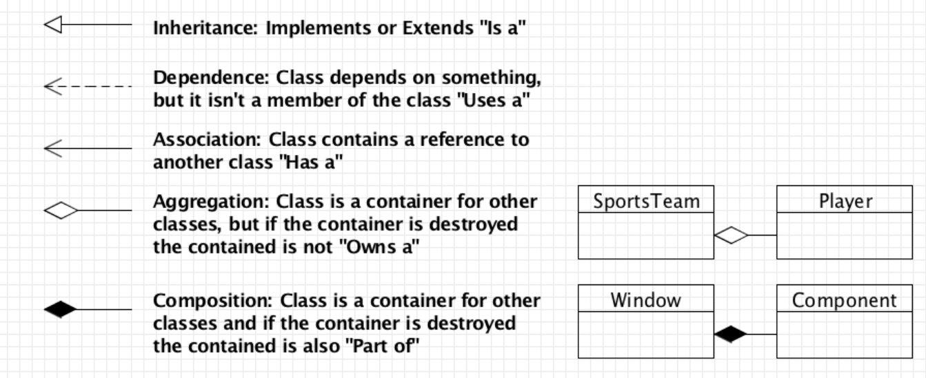
Relationship

Slide 20
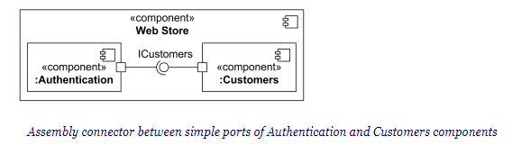
Assembly Connector
When an assembly connector connects simple ports (ports that provide or require a single interface), it may be notated by a "ball-and-socket" connection between a provided interface and a required interface.

Slide 21
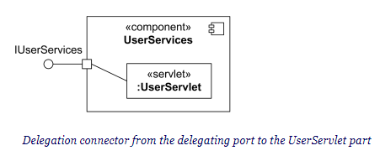
Delegation Connector
A delegation connector is a connector that links the external contract of a component (as specified by its ports) to the realization of that behavior.

Slide 22
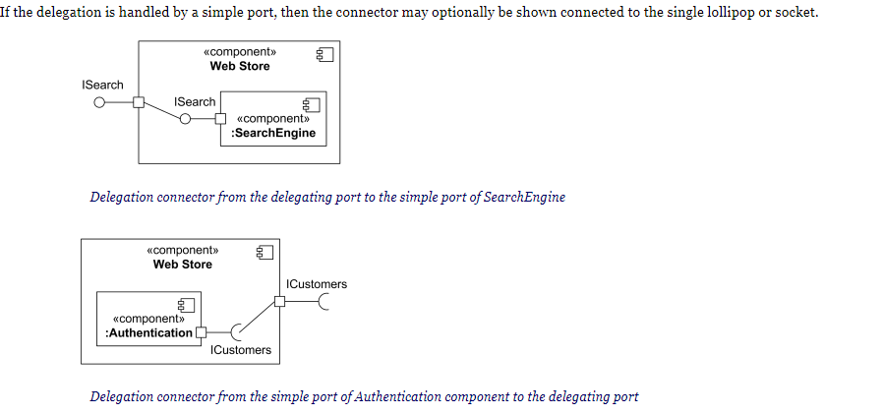
Delegation Connector

Slide 23
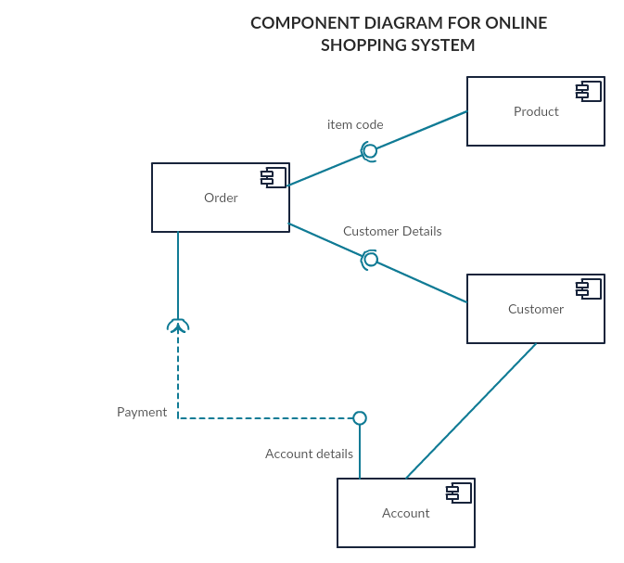
Example

Slide 24

UML Component Diagrams
Component diagram shows components, provided and required interfaces, ports, and relationships between them. This type of diagrams is used
in Component-Based Development (CBD) to describe systems with Service-Oriented Architecture (SOA).
Component-based development is based on assumptions that previously constructed components could be reused and that components could be replaced by some other "equivalent" or "conformant" components, if needed.

Slide 25

UML Component Diagrams
Component are intended to be capable of being deployed and re-deployed independently, for instance to update an existing system.
Components in UML could represent
logical components (e.g., business components, process components), and
physical components (e.g., CORBA components, EJB components, ATL, COM+ and .NET components, WSDL (Web Service Definition Language) components, etc.),

Slide 26

Online Shopping - Components
Summary: The diagram shows "white-box" view of the internal structure of three related subsystems: WebStore, Warehouses, and Accounting.
WebStore subsystem contains three components related to online shopping - Search Engine, Shopping Cart, and Authentication.
Accounting subsystem provides two
interfaces: Manage Orders and Manage Customers.
Warehouses subsystem provides two interfaces: Search Inventory and Manage Inventory used by other subsystems.

Slide 27

Online Shopping - Components
WebStore subsystem contains three components related to online shopping - Search Engine, Shopping Cart,
and Authentication.
Search Engine component allows to search or browse items by exposing provided interface Product Search and
uses required interface Search Inventory provided by Inventory component.
Shopping Cart component uses Manage
Orders interface provided by Orders component during checkout.
Authentication component allows customers to create account, login, or logout and binds customer to some account.
Accounting subsystem provides two interfaces - Manage Orders and Manage Customers.

Slide 28

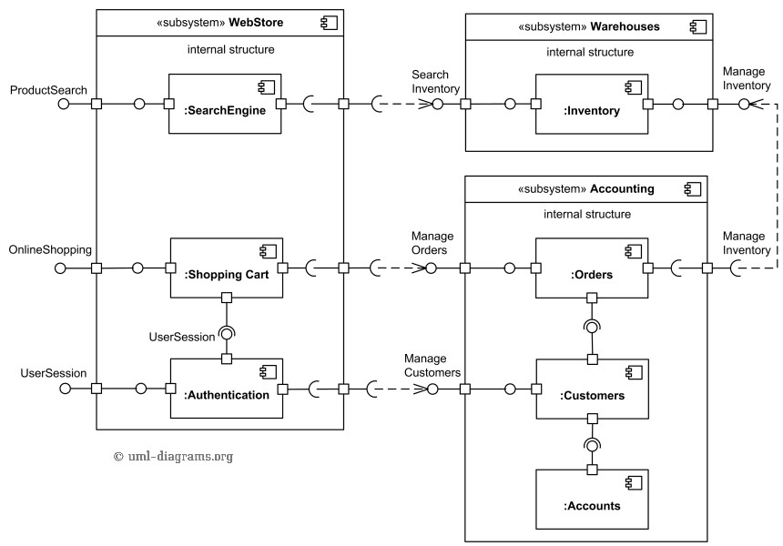
Ex1: Component Diagram

Slide 29

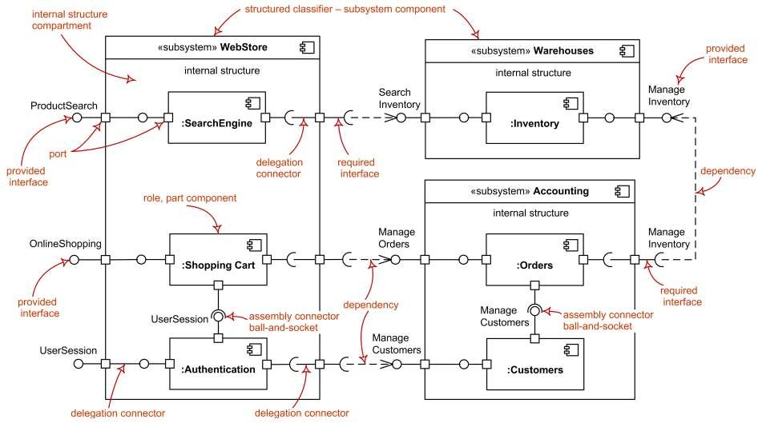
Ex1: UML Component Diagram

Slide 30

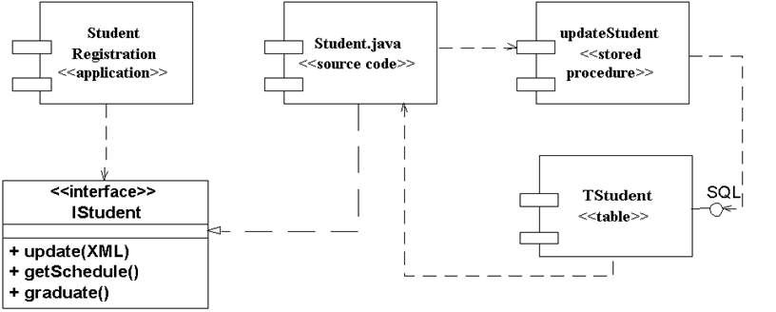
Ex2: Sample interfaces

Slide 31

Online ordering / shipping
Online Ordering and Shipping applications uses Apache Struts framework forMVC. There isa Customer componentwhich provides XML (data) and ICustomer interfaces. There isan Orders componentwhich provides XML (data) and IOrderinterfaces.
Ordering Appuses IOrder & ICustomer interfaces toplaceorders. Shipping Apprequires XML data from Customer component & uses IOrderto link respectiveorders forshipping.
Security infrastrure provides IAccesControl & IEncryption interfaces. IAccesControl isused by Ordering, Shipping, Customers and Orders.
Persistence infrastructure hasa dependency on CorporateDB componentvia JDBC. Persistence infrastructure provides IPersistence used by Customers and Ordersto providestorage persistency for customerorders.

Slide 32

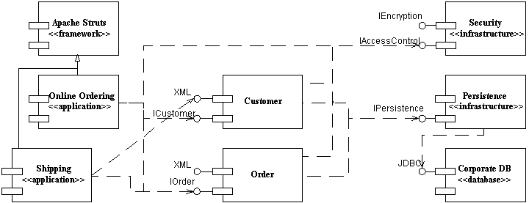
Ex3: Component Diagram

Slide 33

Ex4: Component Diagram
Consider a scenario of a web application where initially customer visits index.html page and from there he has two options: (1) select a category then goto find.html page to search in that category (2) or he can directly jump to the find.html page for direct product search without category. find.html uses Find.exe application, which in-turn uses a Products DLL with static binding and Categories with dynamic binding.
DLL (Dynamic Link Library) , a library of executable functions or data that can be used by a Windows application. Typically, a DLL provides one or more functions and a program can accesses functions by creating either a static or dynamic link to DLL. Static link remains constant during program execution while a dynamic link is created by the program as needed.

Slide 34












Ex4: Component Diagram
executable
find.html
Find.exe
page
Index.html
Dynamic Link
Static Link
Library Package
Category.dll
Products.dll
library

Slide 35

Common Uses:
Model source code:
model configuration mgmt
Model executable releases
Release is relatively complete and consistent set of artifacts delivered to user
Release focuses on parts necessary to deliver running system
Component Diagram visualizes, specifies, and documents the decisions about the physical parts that define the software.

Slide 36

Common Uses: (cont’d)
Model Physical databases:
Component Diagram can represent physical DBs
database is concrete realization of schema
schemas offer an API to persistent information
model of physical DBs represents storage of information in tables of a relational DB or pages of an OO dbase.
Model Adaptable systems:
Adaptable Models support changeable domain modules.
Allow users to add new rules / features to system without new programming.
can model static aspects of adaptable systems
can model dynamic aspects (in conjunction with behavioral models)

Slide 37

Modeling Source Code
(Forward/Reverse Eng): identify set of source code files of interest
 model as components stereotyped as files
Larger systems: use packages to show groups of source code files
Model compilation dependencies among files

Slide 38










Ex5: Modeling Source Code
Signal.h
{version=3.5}
Signal.h
{version=4.0}
Signal.h
{version=4.1}
5 source code files
signal.h (header)
used by 2 other files (signal.cpp, interp.cpp)
interp.cpp has compilation dependency to header file (irq.h)
device.cpp compilation dependency to interp.cpp
<<parent>>
Interp.cpp
<<parent>>
Signal.cpp
Irq.h
Device.cpp

Slide 39

Ex6: Communication Links
 Communication associations support one or more communication protocols, each of which should be indicated by a UML stereotype. In Figure you see that the HTTP, JDBC, and web services protocols are indicated using this approach.

Slide 40

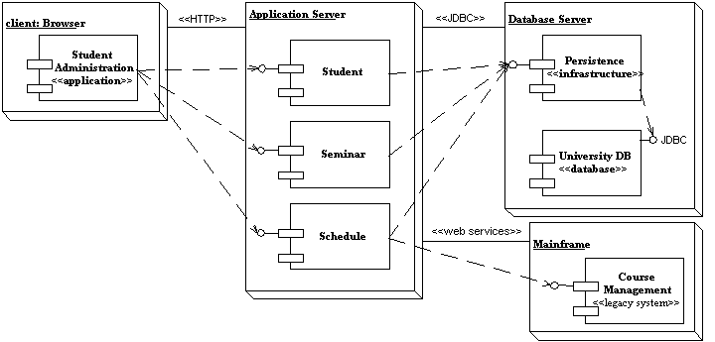
Ex6: Communication Links

Slide 41

Common stereotypes for communication associations.
Asynchronous: An asynchronous connection, perhaps via a message bus or message queue.
HTTP: HyperText Transport Protocol.
JDBC: Java Database Connectivity, Java API for DB access.
ODBC: Open Database Connectivity, (MS API for DB).
RMI: Remote Method Invocation, (Java comm. Protocol).
RPC: Communication via remote procedure calls.
Synchronous: A synchronous connect where the senders waits for a response from the receiver.
web services: Communication is via Web Services protocols
such as SOAP and UDDI

Slide 42

Component Diagram Guidelines
Use Descriptive Names for Architectural Components
Use Environment-Specific Naming Conventions for Detailed Design
Components
Apply Textual Stereotypes to Components Consistently
Avoid Modeling Data and User Interface Components
Interfaces
Prefer Lollipop Notation To Indicate Realization of Interfaces By
Components
Prefer the Left-Hand Side of A Component for Interface Lollipops
Show Only Relevant Interfaces
Dependencies and Inheritance
Model Dependencies From Left To Right
Place Child Components Below Parent Components
Components Should Only Depend on Interfaces
Avoid Modeling Compilation Dependencies

Slide 43




































Common Stereotypes
Stereotype
<<application>>
ASP/JSPs
screens and
<<database>> database.
<<document>>
<<executable>> stereotype.
<<file>>
<<infrastructure>> audit logger.
<<library>>
<<source code>>
<<table>>
<<web service>>
<<XML DTD>>
Indicates
A “front-end” of your system, such as the collection of HTML pages and
that work with them for a browser-based system or the collection of controller classes for a GUI-based system.
A hierarchical, relational, object-relational, network, or object-oriented
A document. A UML standard stereotype.
A software component that can be executed on a node. A UML standard
A data file. A UML standard stereotype.
A technical component within your system such as a persistence service or an
An object or function library. A UML standard stereotype.
A source code file, such as a .java file or a .cpp file.
A data table within a database. A UML standard stereotype One or more web services.
An XML DTD.

Slide 44


Slide 45
Deployment Diagram
Deployment Diagram shows how hardware and software works together
Deployment Diagram is a type of diagram that specifies the physical hardware on which the software system will execute.
It also determines how the software is deployed on the underlying hardware.
It maps software pieces of a system to the device that are going to execute it.

Slide 46

Contents
Deployment diagrams contain:
An artifact
An interface
Nodes
Dependency and association relationships
may also contain components, each of which must live on some node.

Slide 47
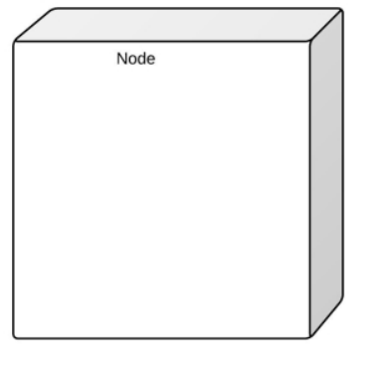
Nodes
It is denoted by a 3D box with the node-name written inside of it.
Node is a computational resource upon which artifacts are deployed for execution.
A node is a physical thing that can execute one or more artifacts.

Slide 48
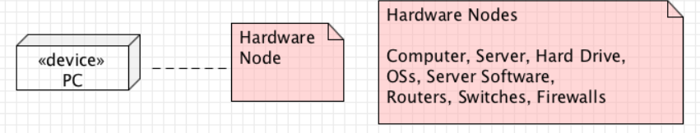
device nodes
There are two types of nodes in a deployment diagram: device nodes and execution environment nodes.
Device nodes are computing resources with processing capabilities and the ability to execute programs. Some examples of device nodes include PCs, laptops, and mobile phones. It is represented using a node with stereotype <<device>>

Slide 49
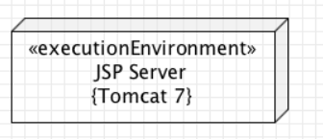
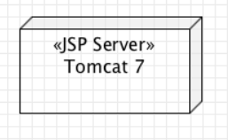
execution environment node
An execution environment node, or EEN, is any computer system that resides within a device node.
It is a node that represents an environment in which software is going to execute. For example, Java applications are executed in java virtual machine (JVM). JVM is considered as an execution environment for Java applications. It could be an operating system, or another servlet container.
Or

Slide 50
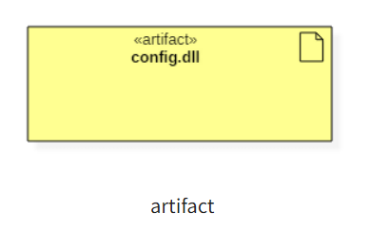
artifact
An artifact represents the specification of a concrete real-world entity related to software development. You can use the artifact to describe a framework which is used during the software development process or an executable file. Artifacts are deployed on the nodes. The most common artifacts are as follows,
Source files
Executable files
Database tables
Scripts
DLL files
User manuals or documentation
Output files

Slide 51
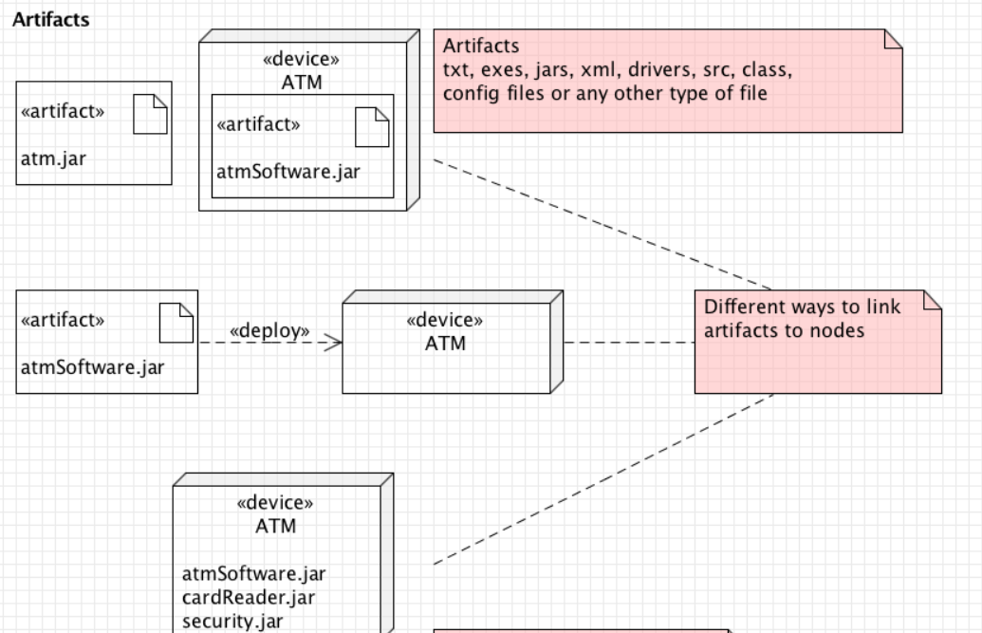
Different ways to link artifacts to nodes

Slide 52
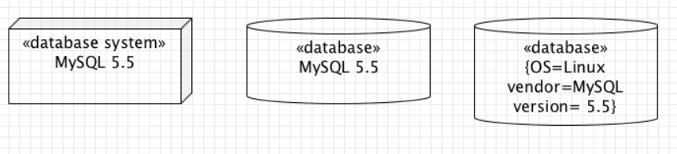
Database
Databases represent any data stored by the deployed system. In some instances, you'll see a database represented as just another node, but sometimes you will see this shape as a database.

Slide 53
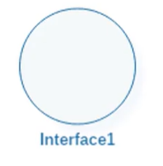
interface

Slide 54
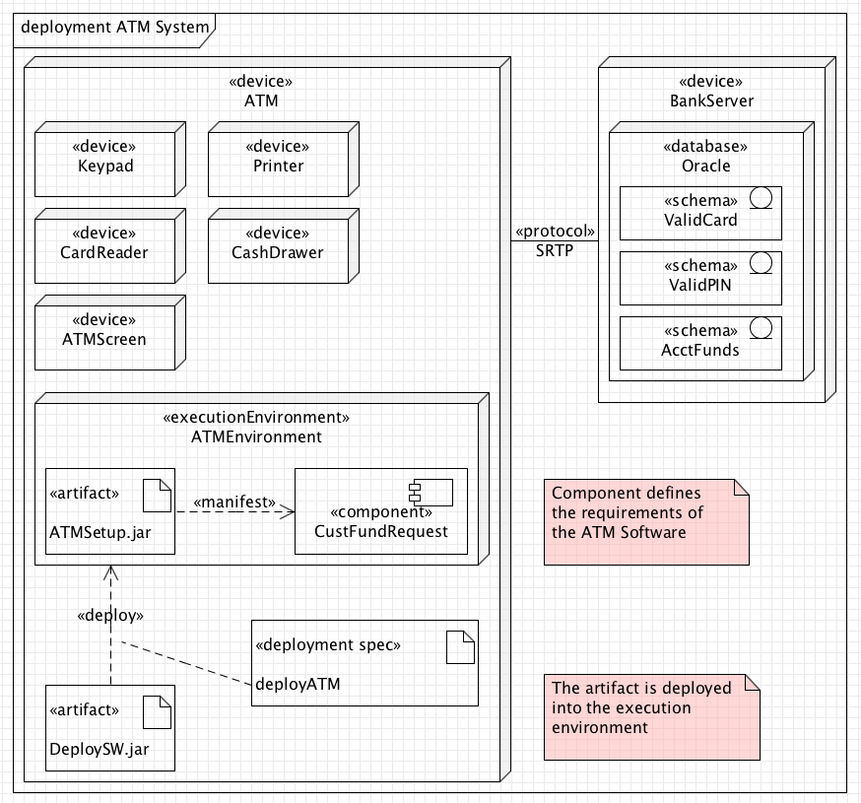
A Deployment Diagram

Slide 55












A Deployment Diagram
Internet
node Modem bank
<<processor>>
Caching server
<<processor>>
Caching server
connection
<<network>> local network
<<processor>> primary server
<<processor>>
<<processor>>
<<processor>>
server
server
server

Slide 56

Modeling Client-Server Architecture
Identify nodes that represent system’s client and server processors
Highlight those devices that are essential to the behavior
 E.g.: special devices (credit card readers, badge readers, special display devices)
Use stereotyping to visually distinguish

Slide 57

















Client-Server System
Human resource system
2 pkgs: client, server
Client: 2 nodes
console and kiosk
stereotyped, distinguishable
Server: 2 nodes
caching server and server
Multiplicities are used
client
console
kiosk
server
4..*
<<processor>> server
Deploys
dbadmin.exe tktmstr.exe logexc.exe
2..*
<<processor>>
Caching server
Deploys
Http.exe rting.exe

Slide 58

Guidelines for Deployment Diagrams
General [Ambler 2002-2005]
Indicate Software Components on Project-Specific
Diagrams
Focus on Nodes and Communication Associations on Enterprise-Level Diagrams
Nodes and Components
Name Nodes With Descriptive Terms
Model Only Vital Software Components
Apply Consistent Stereotypes to Components
Apply Visual Stereotypes to Nodes
Dependencies and Communication Associations
Indicate Communication Protocols Via Stereotypes
Model Only Critical Dependencies Between Components

